Slide 1
Reflection and Refraction

Slide 2
Reflection
Reflection – some or all of a wave bounces back into the first medium when hitting a boundary of a second medium
When all the wave energy is reflected back instead of being transmitted, it is total reflection
If some energy is transmitted and some is reflected, the wave is partially reflected

Slide 3
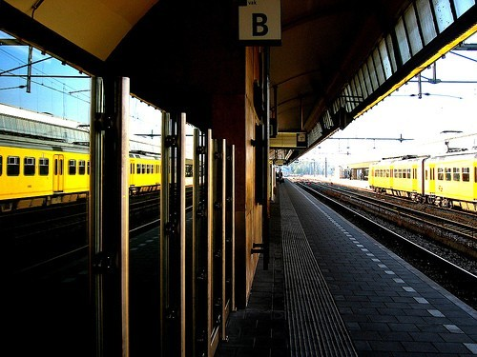
Reflection

Slide 4
The Law of Reflection
The direction of incidence and reflection is best described by straight-line rays
Incident rays and reflected rays make equal angles with a line perpendicular to the surface, called the normal
Angle of Incidence – angle made by the incident ray and the normal
Angle of Reflection – angle made by the reflected ray and the normal
Law of Reflection – the angle of incidence and the angle of reflection are equal

Slide 5
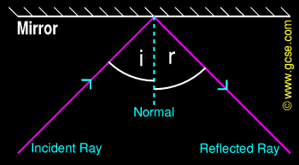
The Law of Reflection

Slide 6
Mirrors
Virtual Image – the point located behind a mirror where an object appears to originate
Your eye cannot tell the difference between an object and its virtual image
The image is as far behind a mirror as the object is in front of the mirror

Slide 7
Diffuse Reflection
Diffuse Reflection – light incident on a rough surface is reflected in many directions
A surface’s roughness is dependent upon the wavelength of the wave incident upon that surface; the longer the wavelength, the smoother the surface will appear
To a piece of paper, light is reflecting diffusely

Slide 8
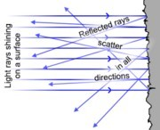
Diffuse Reflection

Slide 9
Reflection of Sound
An echo is reflected sound
Sound reflects from all surfaces of a room
Acoustics is the study of the way sound reflects off of objects in a room
Reverberations – Multiple reflections of sound within a room
The walls of concert halls are designed to make the reflection of sound diffuse

Slide 10
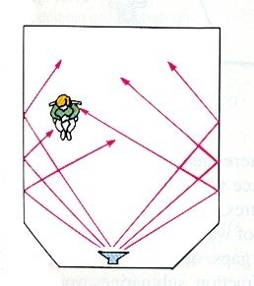
Reflection of Sound

Slide 11
Refraction
Refraction – the change in direction of a wave as it crosses the boundary between two media in which the wave travels at different speeds
Wave Fronts – lines that represent the position of different crests
At each point along a wave front, the wave is moving perpendicular to the wave front
The direction of motion is best represented by a ray

Slide 12
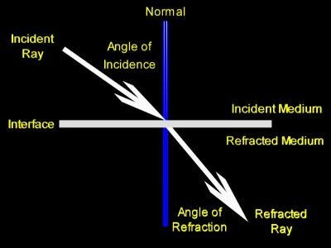
Refraction

Slide 13
Refraction of Sound
Sound waves are refracted when parts of a wave front travel at different speeds
This happens in uneven winds or temperatures
Sound waves tend to bend away from warm ground, since it travels faster in warmer air
On a cold night, the speed of sound is slower near the ground than above, so we can hear over larger distances

Slide 14
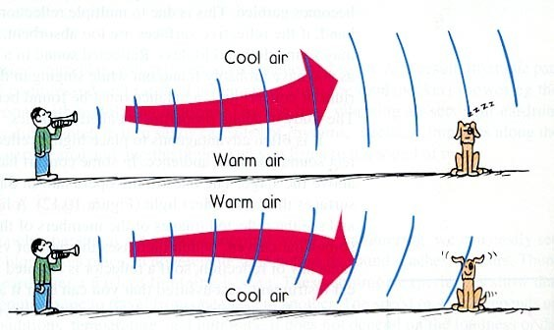
Refraction of Sound

